Slide 1
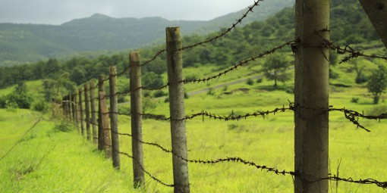

Fences
Zoning & Building Requirements

Slide 2
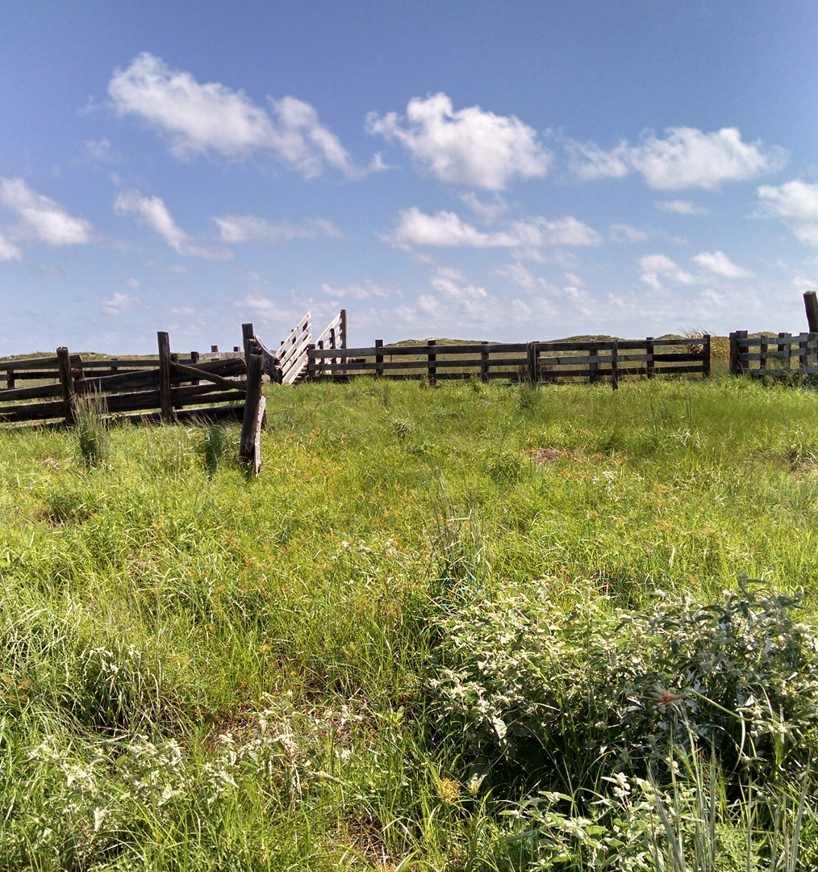
Agenda
Definitions
Height & Visibility Limitations
Triangular Area
When is a Zoning Clearance Required?
When is a Building Permit Required?

Slide 3
Definitions
Topic one

Slide 4
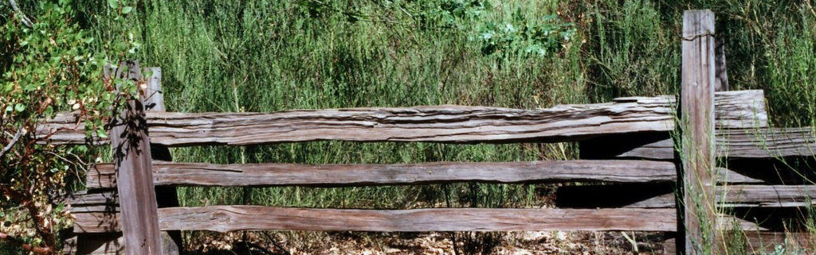
Fence
An artificially constructed barrier of any material or combination of materials erected in such a manner as to control entrance to, enclose, screen or mark the boundaries of a property.

Slide 5
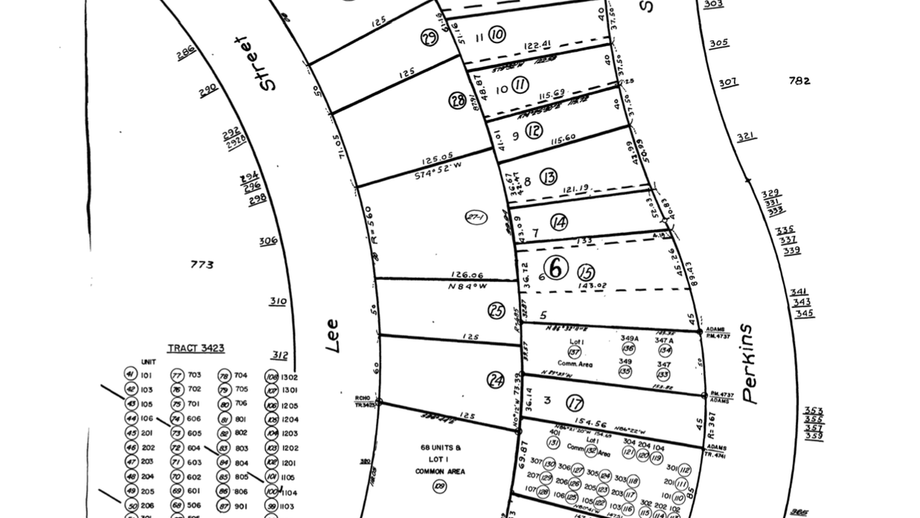
Property Lines
Those lines outlining the boundaries of properties on lots for the purpose of description in sale, lease, building development, or other separate use of property.
This Photo by Unknown Author is licensed under CC BY

Slide 6
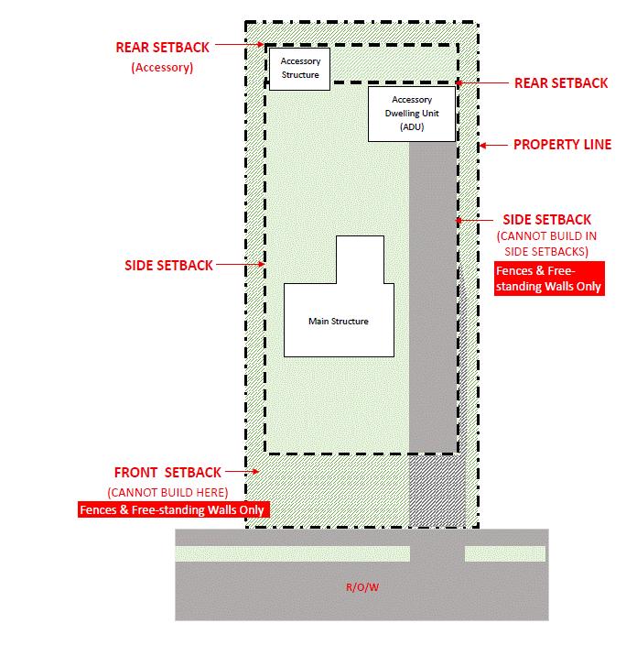
Setbacks
The distance between the street right-of-way line or a property line and the front, rear or side line of a building or any projection thereof; and which extends across the full width or depth of a lot, and in which no building or structure shall be constructed, except as provided in this Zoning Ordinance; also see “YARD”.

Slide 7
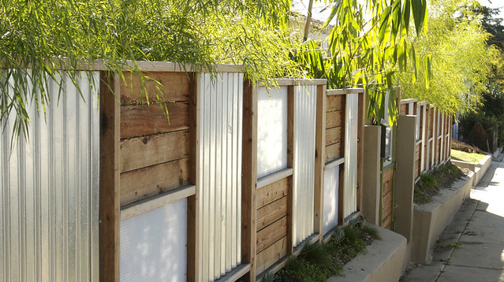
Opaque Fences
Not able to be seen through – not transparent

Slide 8

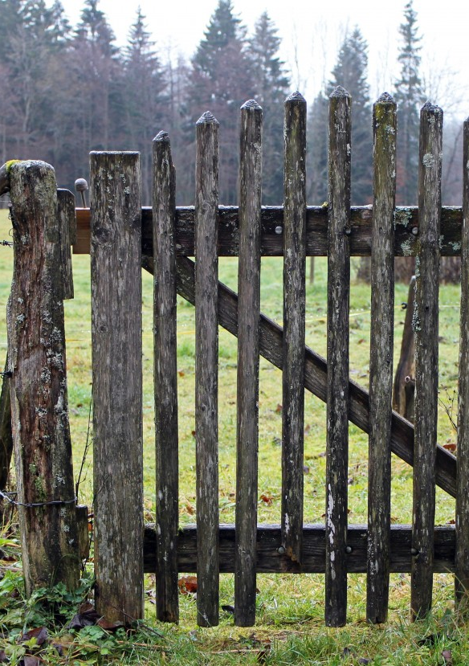
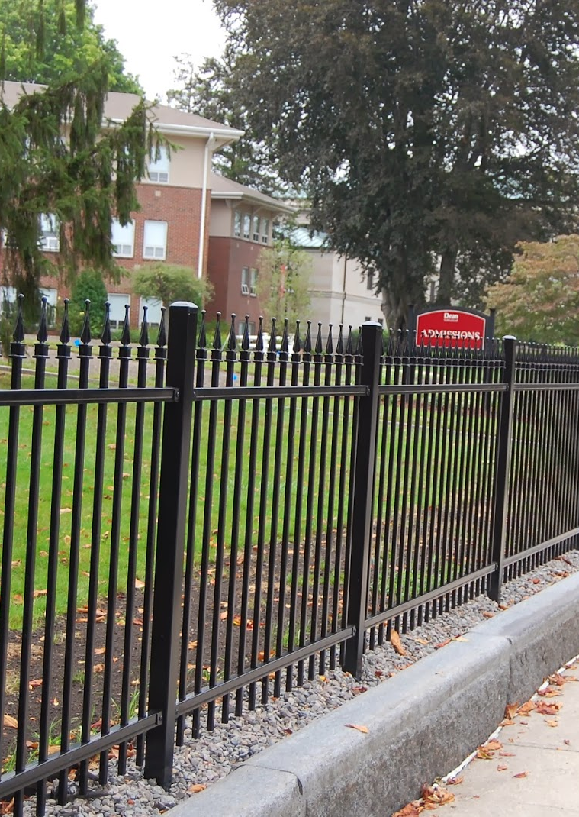
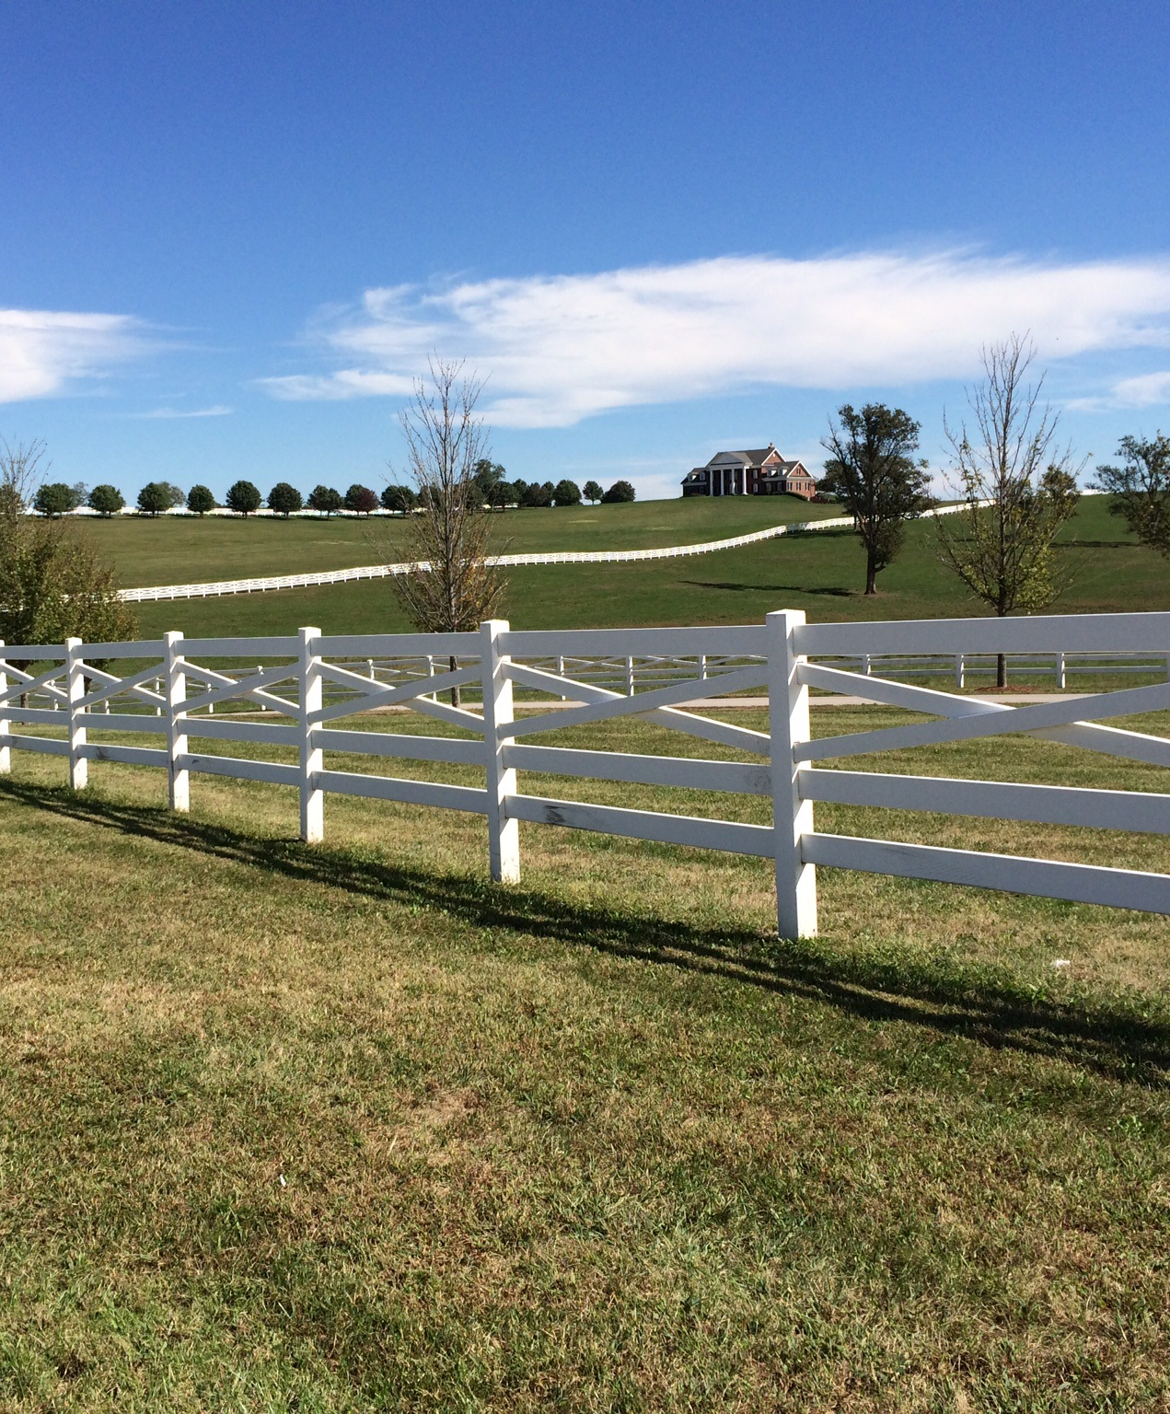
Nonopaque
Nonopaque: Not opaque (not solid)

Slide 9
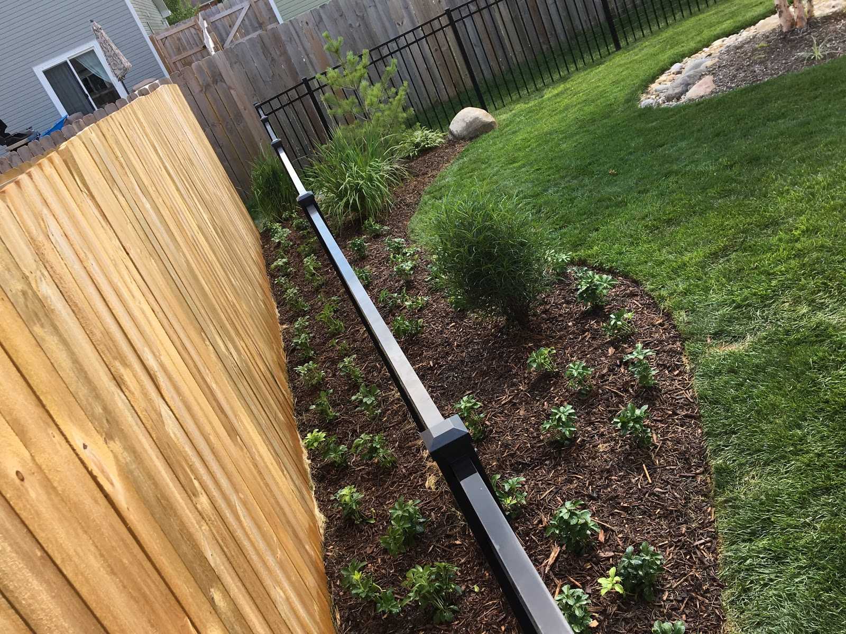
Which one is Opaque?
This Photo by Unknown Author is licensed under CC BY-NC

Slide 10
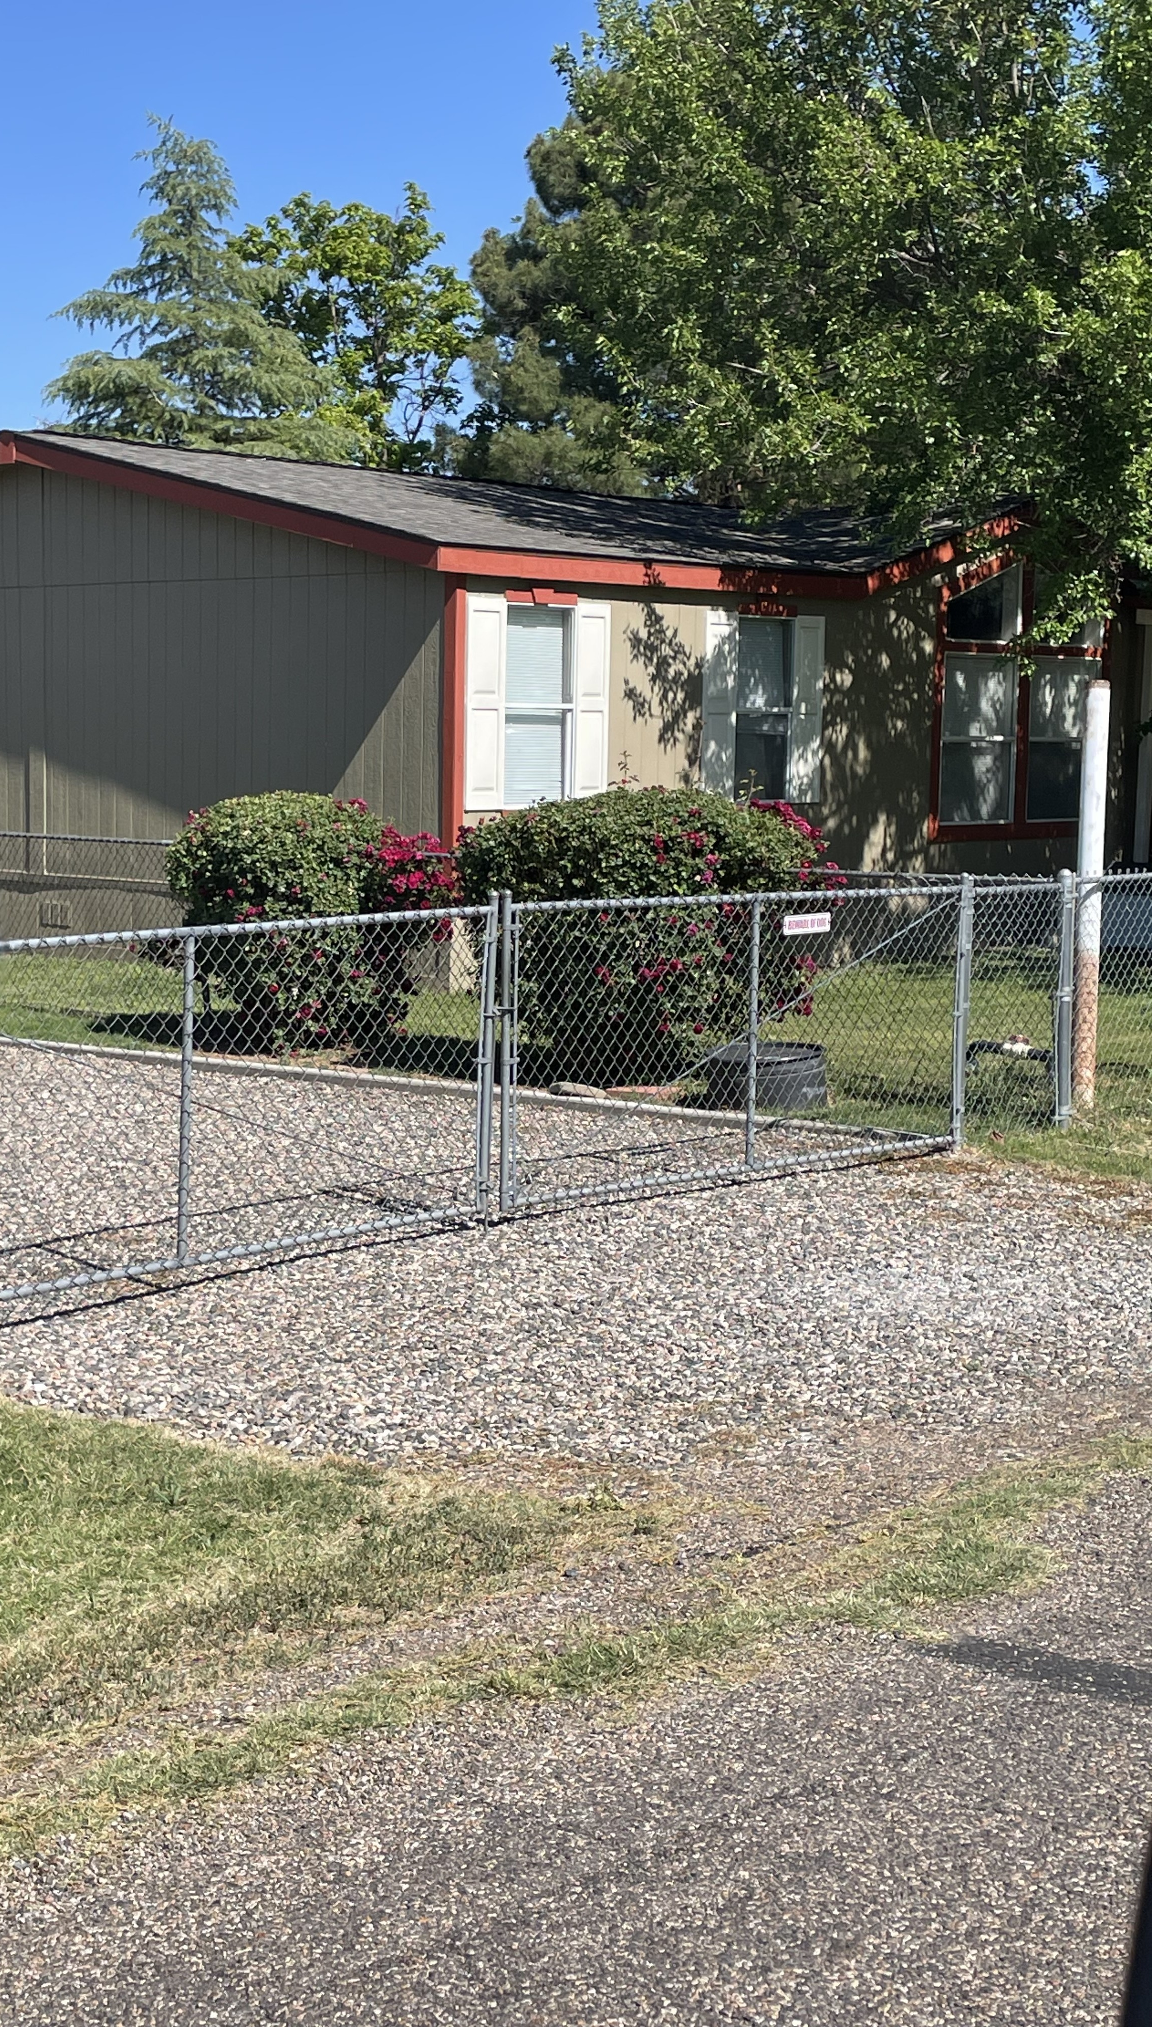
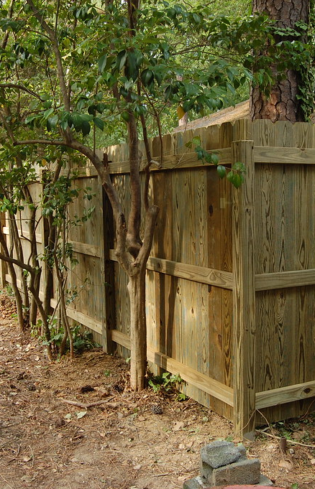
Height & Visibility Limitations
Topic 2
This Photo by Unknown Author is licensed under CC BY-SA

Slide 11

How is the Height of a Fence Measured?
The maximum height of a fence or freestanding wall is determined by measuring from the finished grade at the base of the fence or wall.
Planning & Zoning Ordinance
Section 301.B.2.a.

Slide 12
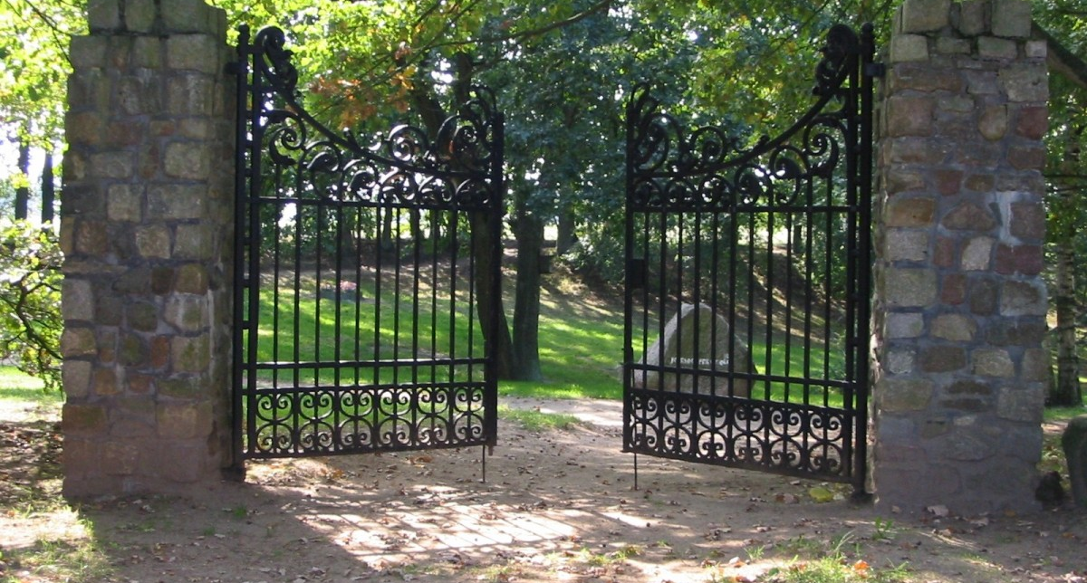
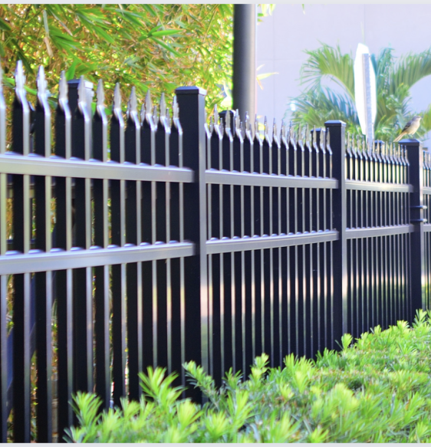
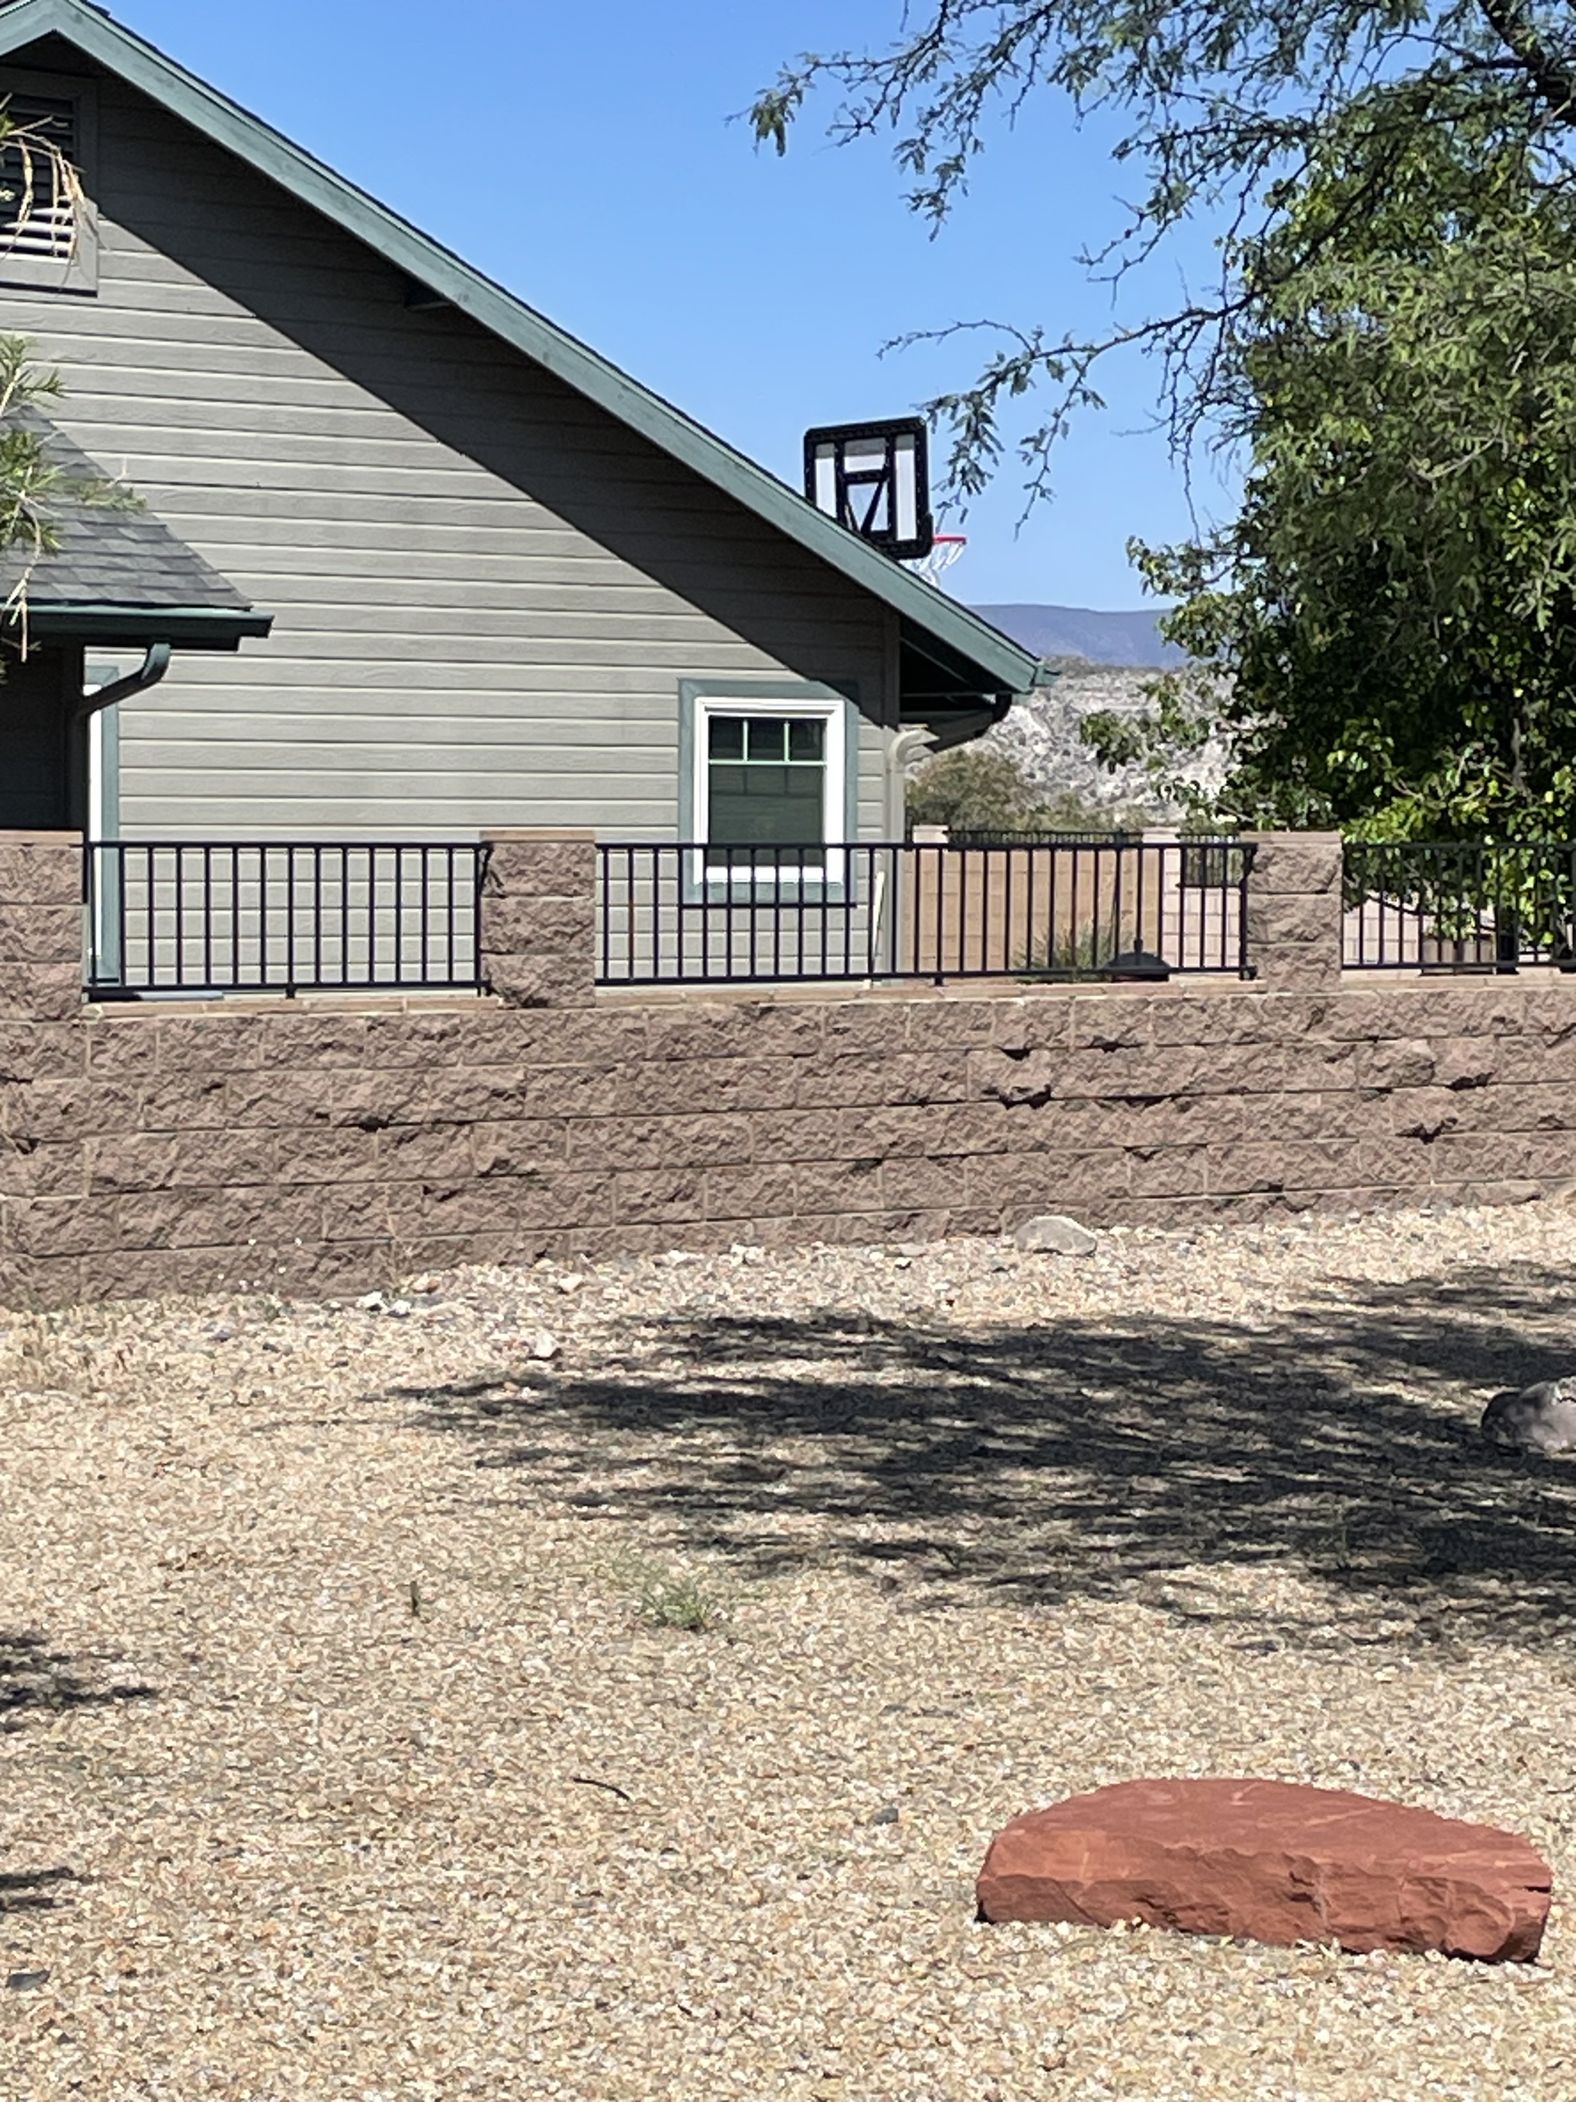
Fencing in the front setback
Fences or freestanding walls, not to exceed a height of six (6) feet in any required front yard, with at least the top two (2) feet open fencing, not opaque or solid… Section 301.B.2.b.1
Three (3) feet within the triangular area… Section 301.B.2.b.2
This Photo by Unknown Author is licensed under CC BY-NC-ND

Slide 13
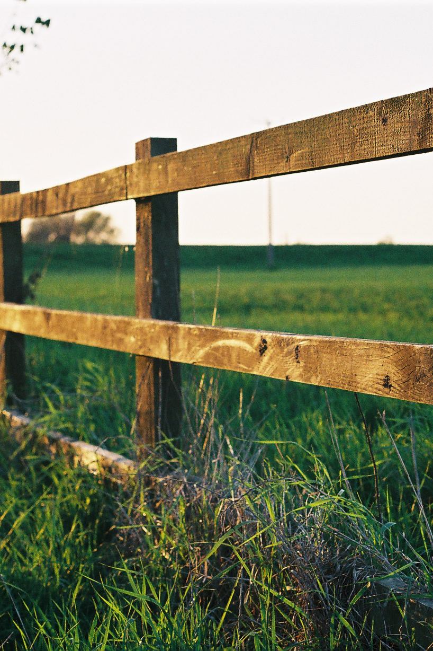
Exceptions to the Rule - Vacant Lots
Vacant parcels may be fenced, prior to installation of a principle use or structure. Such fences shall comply with all other zoning requirements. Additionally, if the parcel or lot is vacant, then all perimeter fencing shall be non-opaque in order that the parcel may be clearly seen/observed. Section 301.C.1
This Photo by Unknown Author is licensed under CC BY-SA

Slide 14
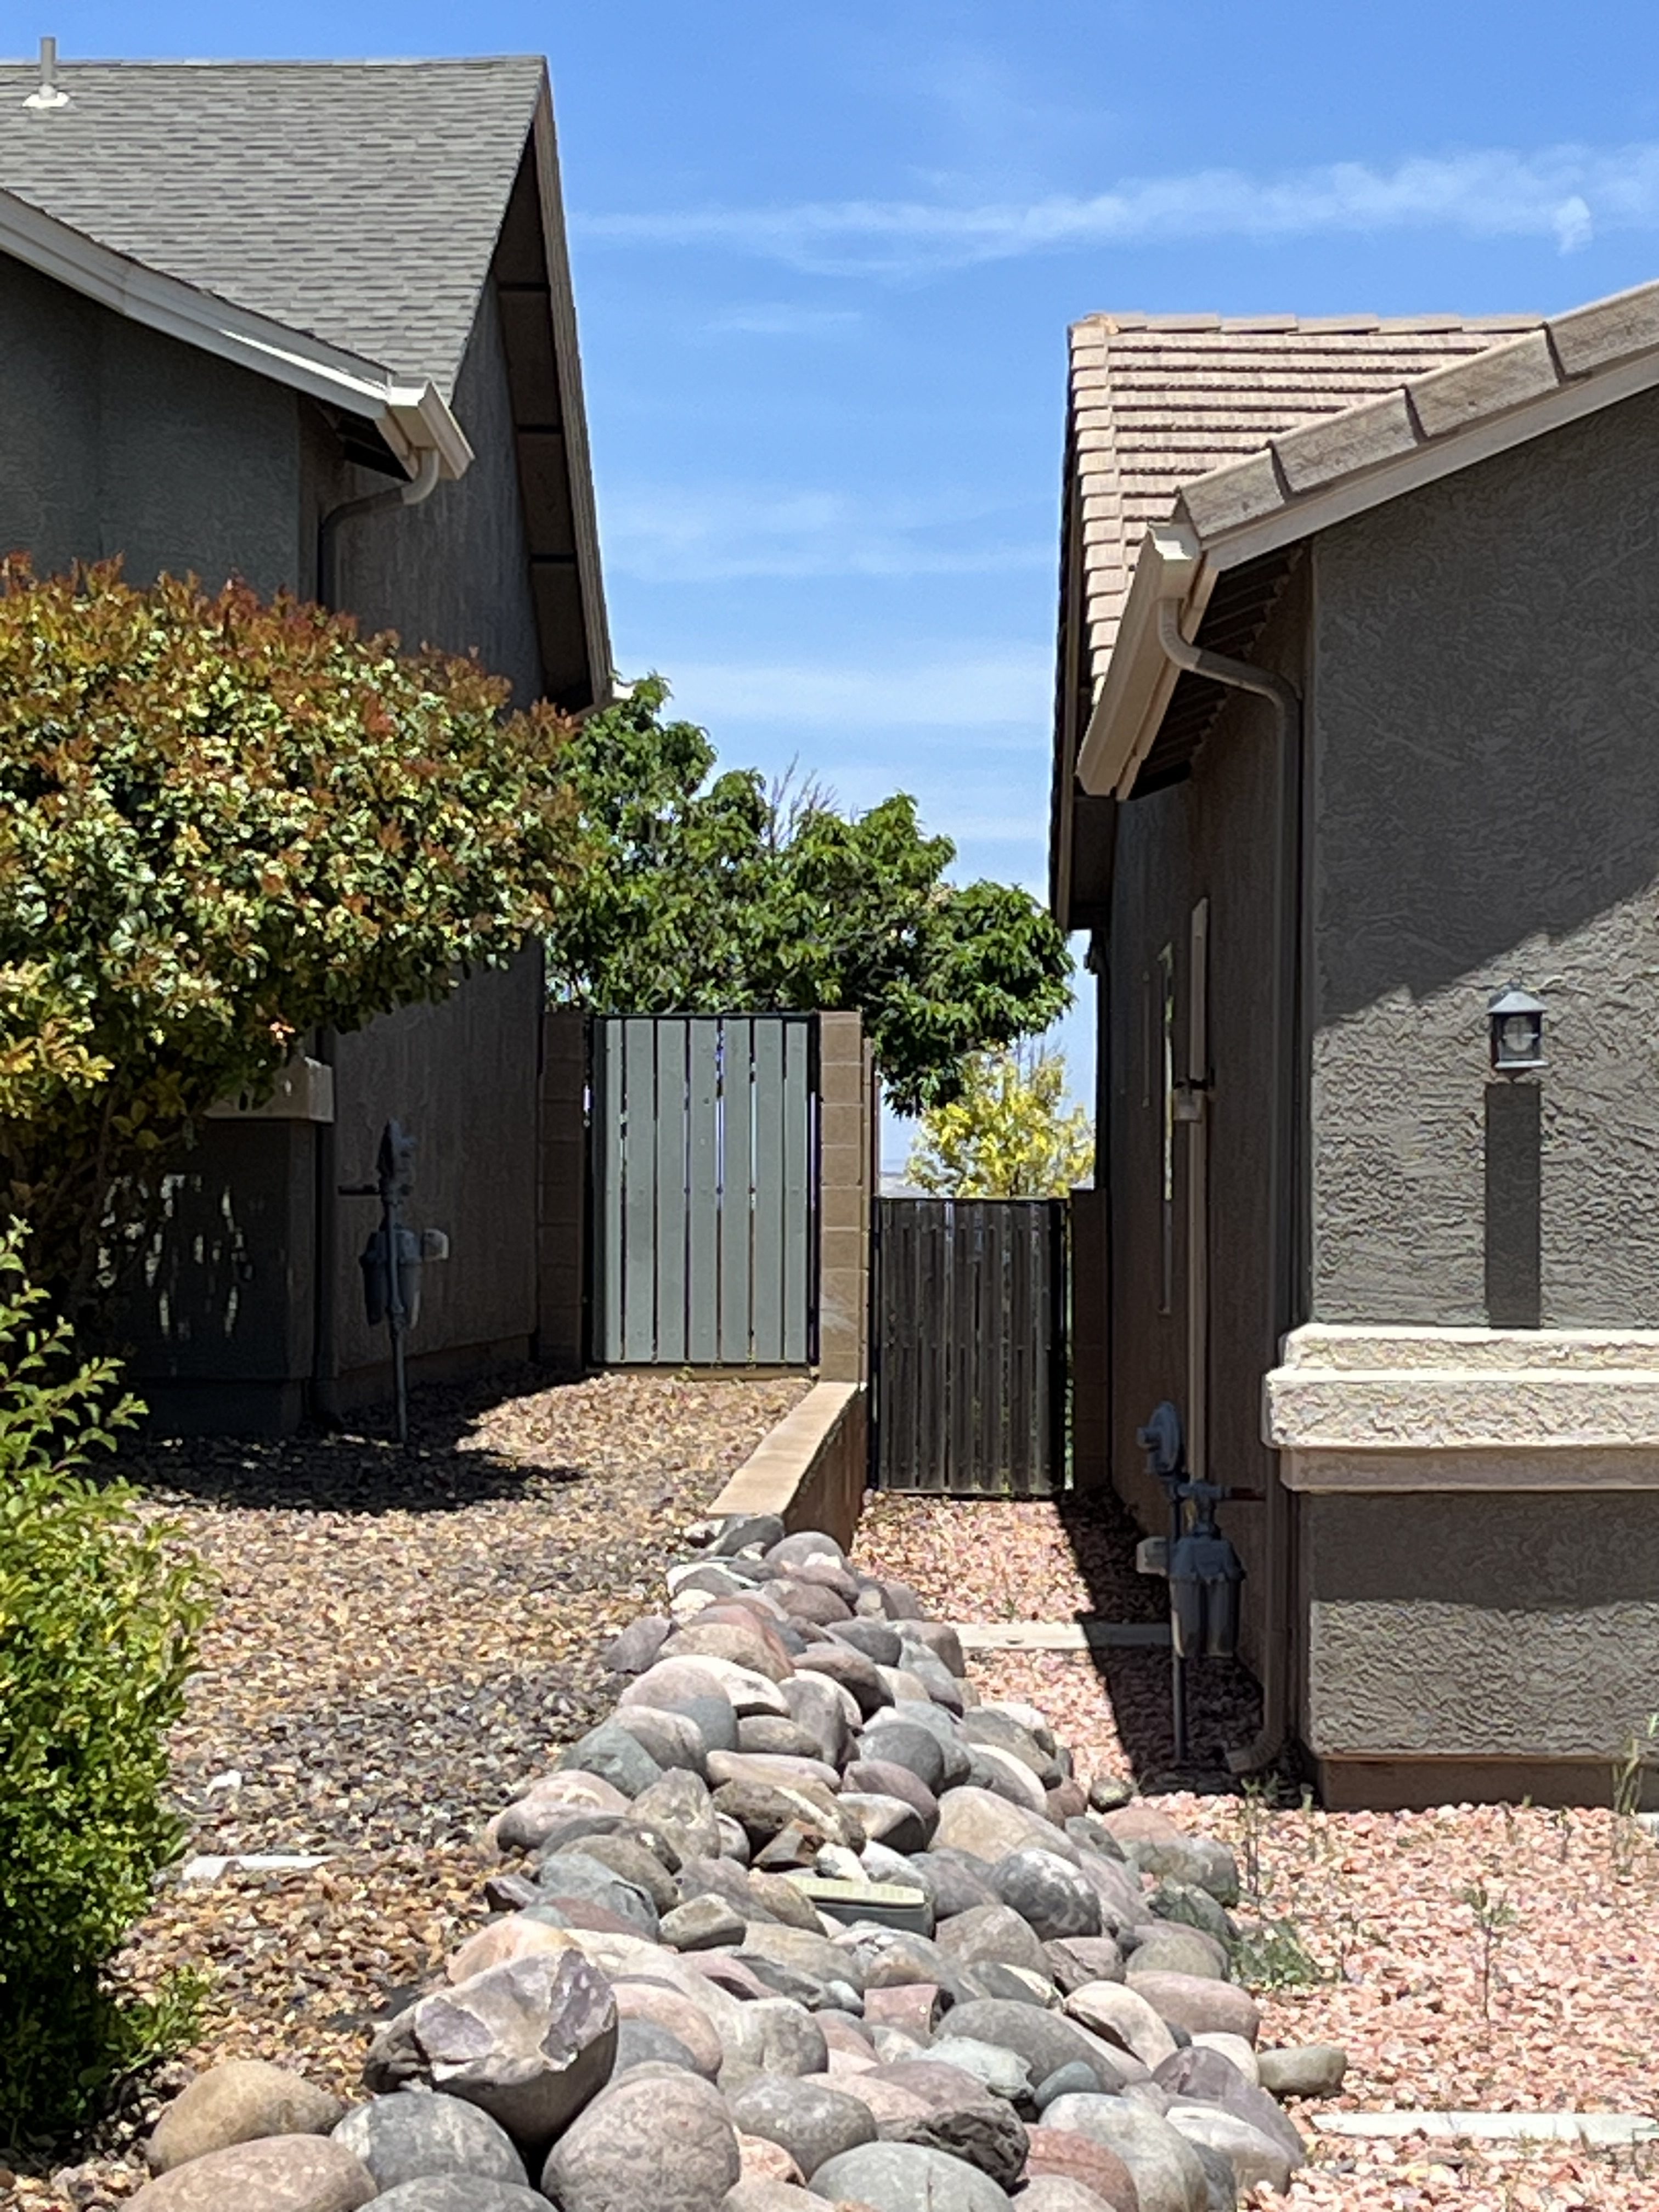
Height Exceptions
A fence or freestanding wall may be erected or altered up to a height of eight (8) feet where there is an elevation difference of two (2) feet or more between adjacent lots. For purposes of measuring height, the maximum height of eight (8) feet shall be measured from whichever side is taller.
Exceptions to height limits in conjunction with retaining walls: In instances where a property has been elevated by fill and an approved and permitted retaining wall, a 6' (6) foot fence would be permitted installed on top of the retaining wall subject to all other fence requirements excepting the height limitation.
Planning & Zoning Ordinance
Sections 301.B.2.3 and 301.B.2.7

Slide 15
Other Exemptions
On commercial and industrial zoned lots: eight feet (8’), except as noted below for utility companies and state licensed marijuana cultivation operations.
a. Utility companies such as APS (Arizona Public Service Company), Salt River Project, Unisource, etc. providing support and services for public utilities, are exempt from wall-fence height limits as these installations often require higher walls-fences in order to protect critical infrastructure. Perimeter fences for these utility companies will be only as tall as minimally required by each company.
Where a fence or wall is required as a screening or other protection for residentially-zoned lots, it shall comply with the height limits for fences on residentially-zoned lots.
Commercial /Industrial
Exception for utility companies and commercial marijuana cultivation:
b. Marijuana cultivation facilities, with approved cultivation licenses through Arizona Department of Health Services, are exempt from wall-fence height requirements of this section. Fences for cultivation facilities will be required to meet Arizona State Law requirements.
Planning & Zoning Ordinance
Sections 301.B.4, 5, and 6.a.b.

Slide 16
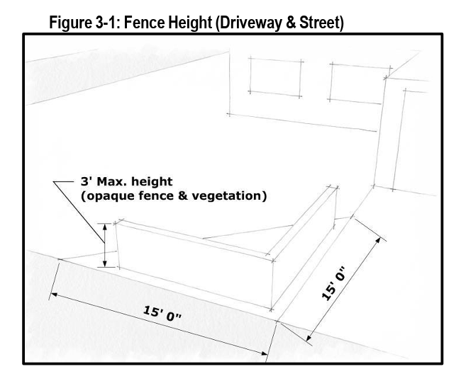
Triangular Area
Topic 3
Three feet (3) within the triangular area formed by measuring 15 feet along the boundary of roadways and drives from their intersection. This three-foot limit includes hedges and other plantings but may include open fencing above three feet to otherwise permitted height. Section 301.B.2.2
Note: The triangular area is measured from the corner points of your property lines on a corner lot, and/or the corner points of the property line along each side of the driveway.

Slide 17
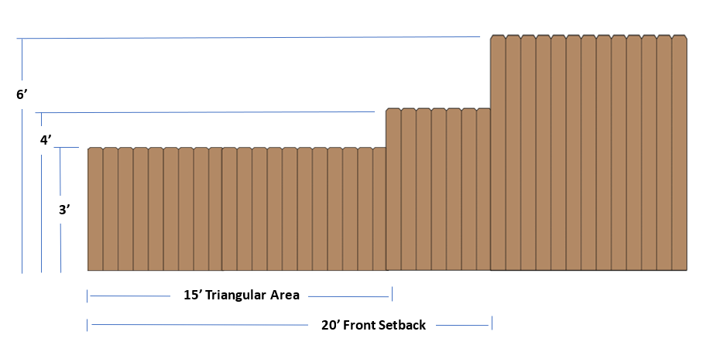
Triangular Area - Side Yard Fenceline
Opaque

Slide 18
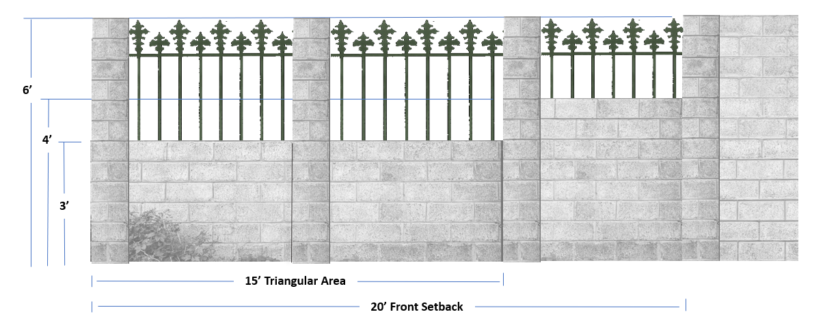
Triangular Area - Side Yard Fenceline
Mixed –Opaque & Nonopaque

Slide 19
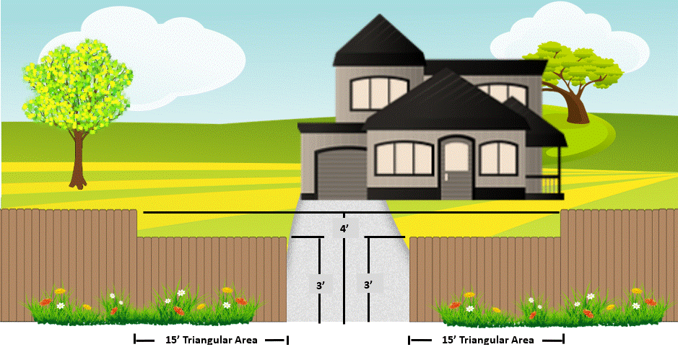
Triangular Area - Driveway
Opaque

Slide 20
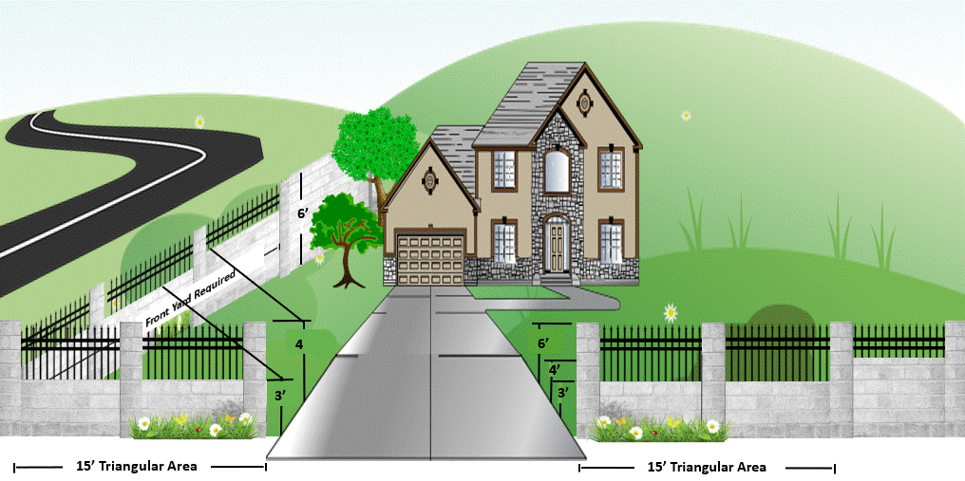
Triangular Area – Driveway & Corner
Mixed –Opaque & Nonopaque

Slide 21
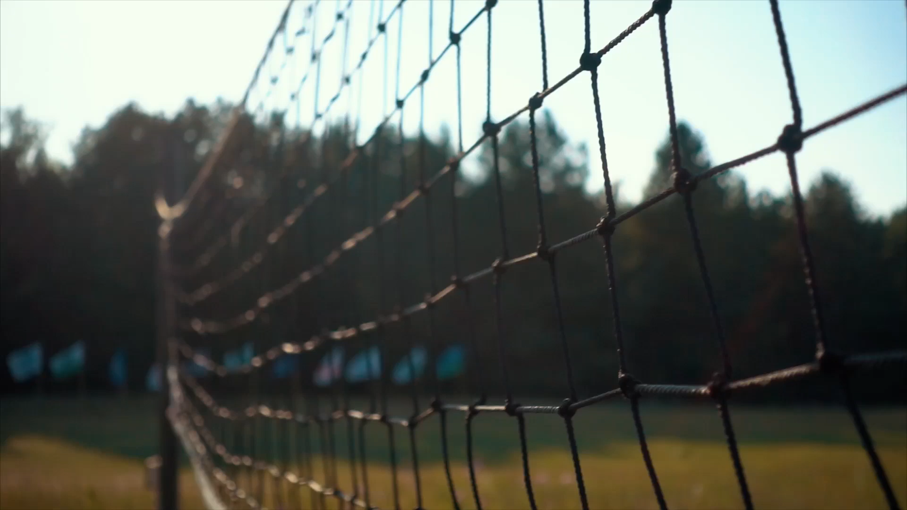
When is a Zoning Clearance Required?
Topic 4

Slide 22
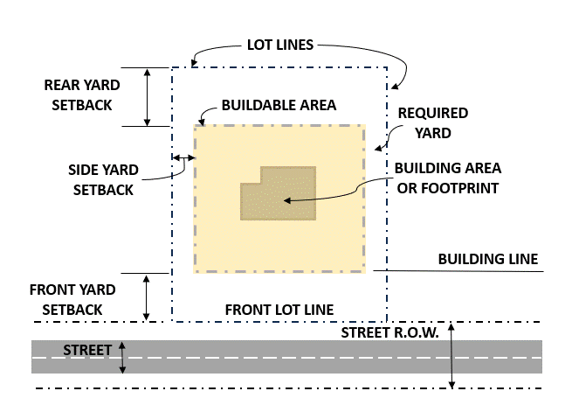
Is a Zoning Clearance Required?
YES
Fences within the required setbacks
Fences in FEMA regulated flood zones require a permit regardless of the placement.
NO
Interior Fences (unless in a FEMA regulated flood zone)

Slide 23
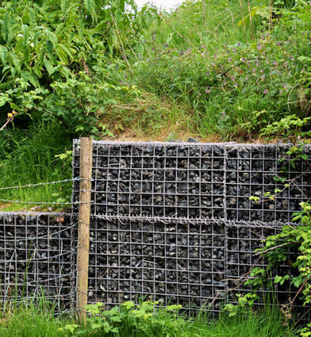
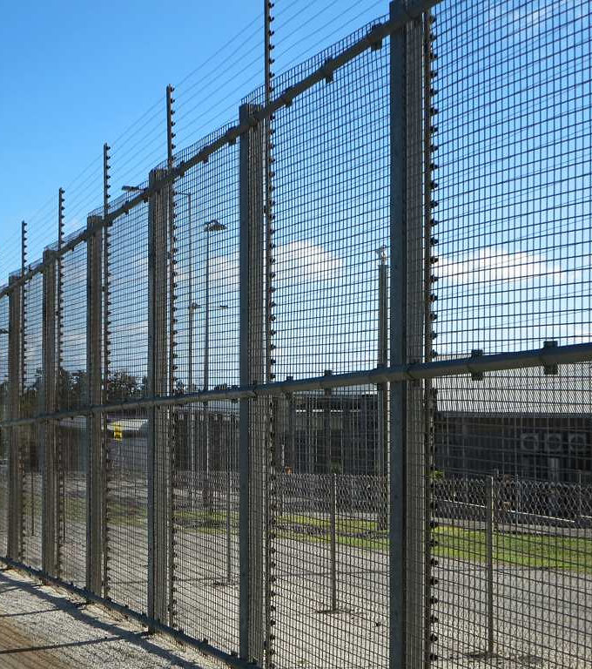
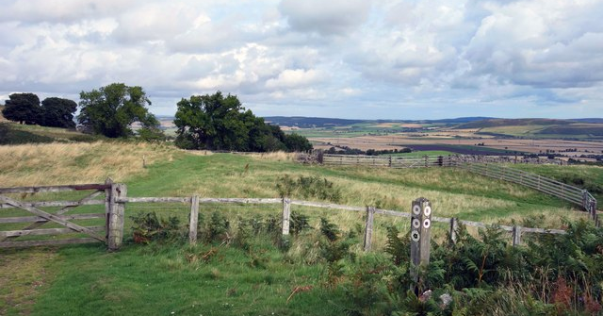
When is a Building Permit Required?
This Photo by Unknown Author is licensed under CC BY-SA
Topic 5
This Photo by Unknown Author is licensed under CC BY-SA

Slide 24
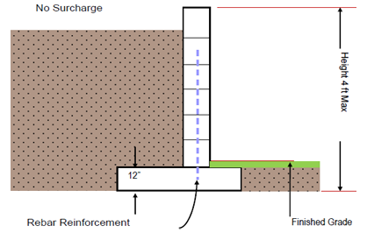
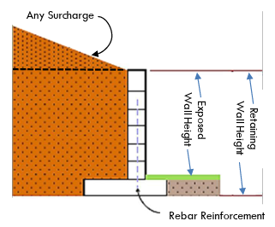
Do I Need a Permit?
NO
YES
Fences under 7’
Retaining walls that are not over 4’ in height measured from the bottom of the footing to the top of the wall, unless supporting a surcharge.
Fences 7’ or greater
Block, brick, concrete, gabion, and like walls
Retaining walls of any height that support a surcharge.

Slide 25
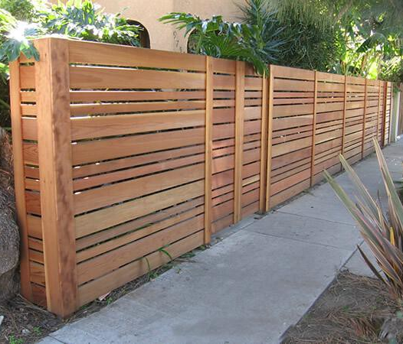
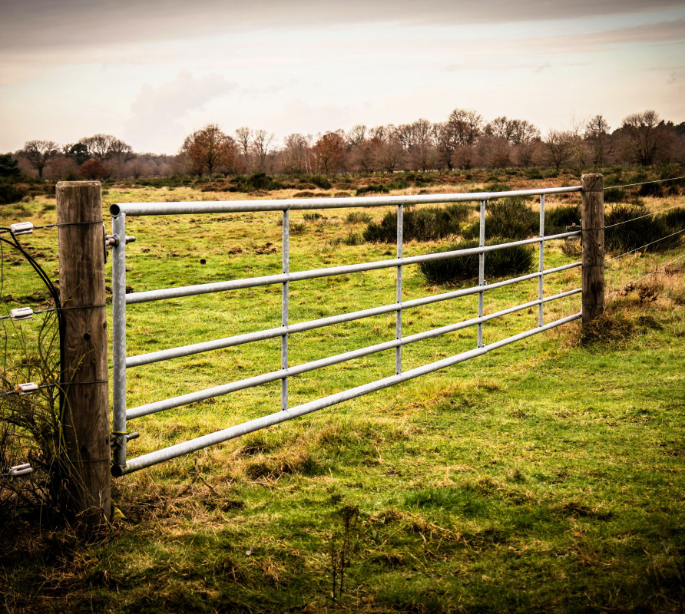
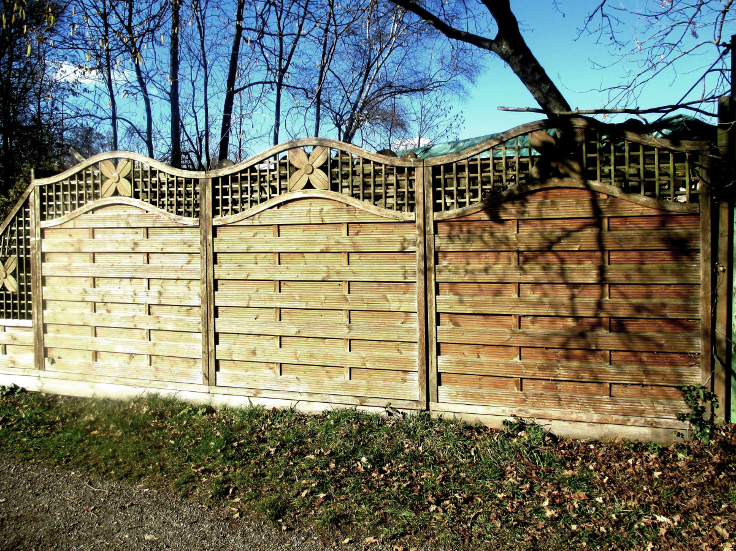
Opaque or
Nonopaque?

